Slide 1
Citi HackOverflow
Code FC

Slide 2
Wealth Management
As mentioned, Citi aims to:
Drive Client Acquisition
Strengthen Client relationships

Slide 3
Communication
Informed Clients
Investments performance
Market updates
Preparing Relationship Managers
Understand clients’ aims
Tailored recommendations
Notes:
Especially in this volatile market, we believe that clients want to be informed on the latest happenings in the markets, and most importantly how’s their investment doing.

Slide 4
Our Solution
We created a client-bank scheduler app
Citi Wealth Scheduler
Client and Banker web portal
Client chooses the appointment dates
More details ahead…

Slide 5
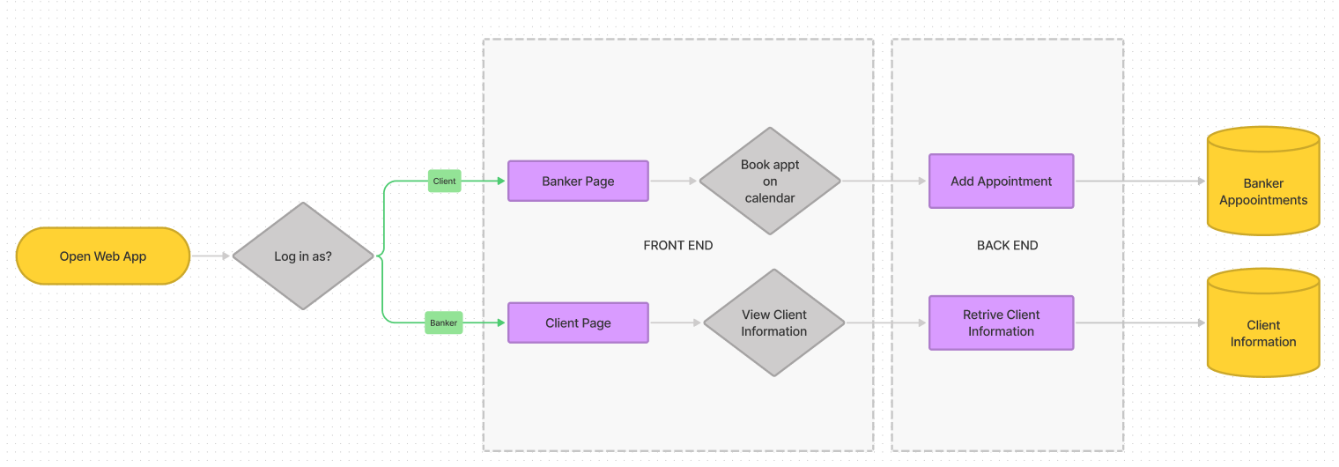
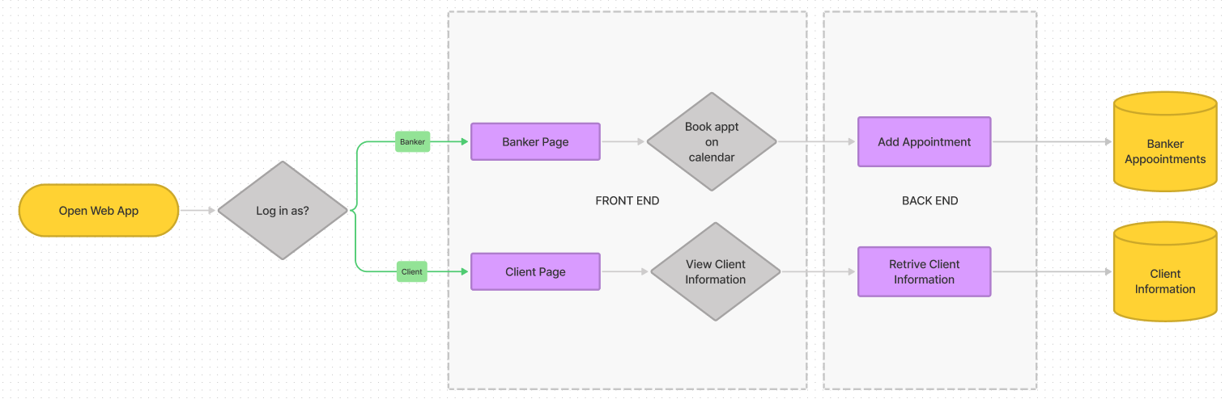
At a Glance…

Slide 6
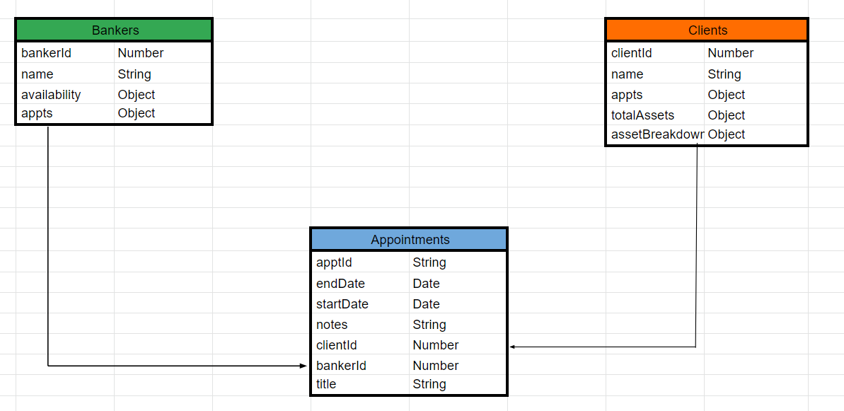
Database (visualised)

Slide 7
Demo
Live Demonstration of Citi Wealth Scheduler

Slide 8
Tech Stack
Application was built using MERN stack
Considerations
React.js : Popular web framework, reusable components
MongoDB: Use of schemas for easy implementation
Express Server: Simple code implementation
Node.js: Consistent with the JavaScript environment

